Slide 2
Agent design
The environment type largely determines the agent design
Fully/partially observable => agent requires memory (internal state)
Discrete/continuous => agent may not be able to enumerate all states
Stochastic/deterministic => agent may have to prepare for contingencies
Single-agent/multi-agent => agent may need to behave randomly

Slide 3
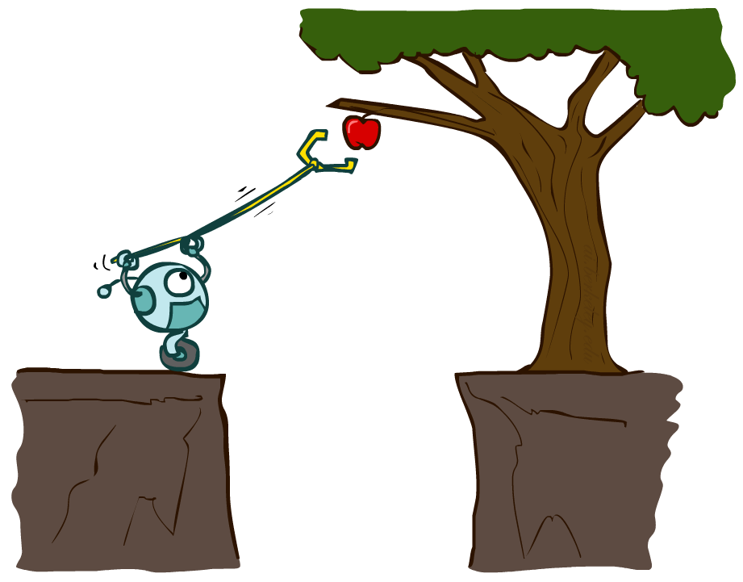
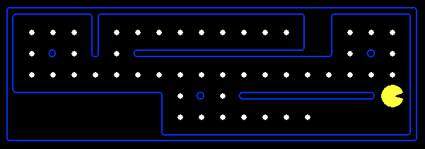
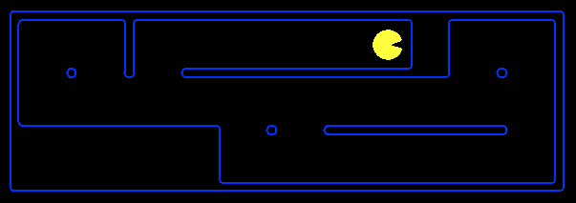
Planning Agents
Planning agents:
Ask “what if”
Decisions based on (hypothesized) consequences of actions
Must have a model of how the world evolves in response to actions
Must formulate a goal (test)
Consider how the world WOULD BE
Optimal vs. complete planning
Planning vs. replanning

Slide 4
Problem solving agents
Uses atomic representations – states are considered as whole with no internal structure visible to the problem
Goal formulation – based on the current situation and the agent’s performance measure
Problem Formulation – what actions and states to consider given a goal.
Environment is observable, discrete, deterministic
Process of looking for a sequence of actions is called search
Search takes a problem as input and returns a solution in the form of an action
Actions are carried out in the execution phase

Slide 5
Search problems
Initial state - starting point
Actions – description of the possible actions available
Applicable actions – From a state ‘s’ what actions are possible
Transition model – A description of what each action does
Successor – state reachable from a given state
State space – set of all states reachable from the initial state by any sequence of actions
Graph – Nodes are states and the links between the nodes are actions
Path – sequence of states

Slide 6
Goal test – test to verify whether a state is goal
Path cost – Function to assign a numeric cost to each path
Solution – leads from start state to final state

Slide 7

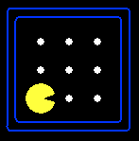





Search Problems
A search problem consists of:
A state space
A successor function
(with actions, costs)
A start state and a goal test
A solution is a sequence of actions (a plan) which transforms the start state to a goal state
“N”, 1.0
“E”, 1.0
Notes:
Often comes back on exams
Goal test – sometimes more than one state that satisfies having achieved the goal, for example, “eat all the dots”
Abstraction

Slide 8

Search Problems Are Models

Slide 9
Example: Traveling in Romania
State space:
Cities
Successor function:
Roads: Go to adjacent city with cost = distance
Start state:
Arad
Goal test:
Is state == Bucharest?
Solution?

Slide 14
Agent design
The environment type largely determines the agent design
Fully/partially observable => agent requires memory (internal state)
Discrete/continuous => agent may not be able to enumerate all states
Stochastic/deterministic => agent may have to prepare for contingencies
Single-agent/multi-agent => agent may need to behave randomly

Slide 15
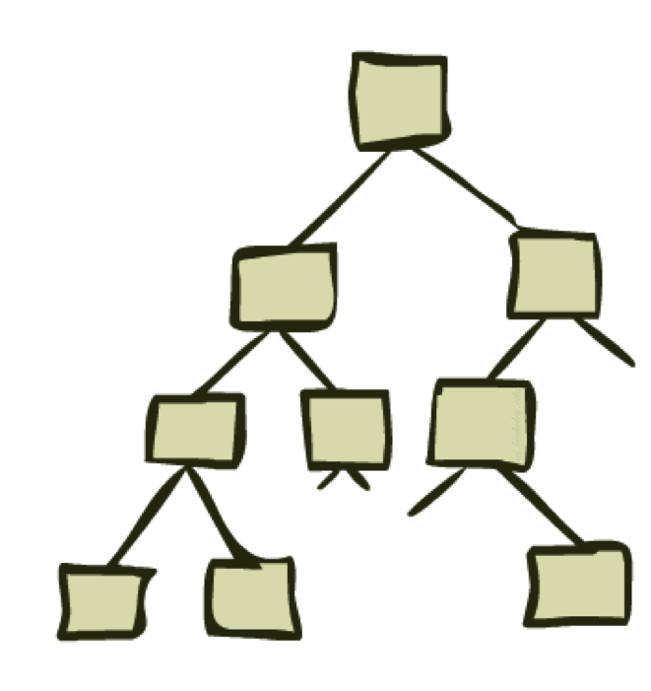
State Space Graphs and Search Trees

Slide 16
State Space Graphs
State space graph: A mathematical representation of a search problem
Nodes are (abstracted) world configurations
Arcs represent successors (action results)
The goal test is a set of goal nodes (maybe only one)
In a state space graph, each state occurs only once!
We can rarely build this full graph in memory (it’s too big), but it’s a useful idea

Slide 17
State Space Graphs
State space graph: A mathematical representation of a search problem
Nodes are (abstracted) world configurations
Arcs represent successors (action results)
The goal test is a set of goal nodes (maybe only one)
In a state space graph, each state occurs only once!
We can rarely build this full graph in memory (it’s too big), but it’s a useful idea
a
G
b
c
e
d
f
S
h
p
q
r
Tiny state space graph for a tiny search problem

Slide 18
Search Trees
This is now / start
“N”, 1.0
“E”, 1.0
Possible futures
A search tree:
A “what if” tree of plans and their outcomes
The start state is the root node
Children correspond to successors
Nodes show states, but correspond to PLANS that achieve those states
For most problems, we can never actually build the whole tree
Notes:
Different plans that achieve the same state, will be different nodes in the tree.

Slide 19
State Space Graphs vs. Search Trees
State Space Graph
Each NODE in in the search tree is an entire PATH in the state space graph.
Search Tree
S
a
G
d
e
p
b
c
q
b
c
e
h
r
d
e
f
a
a
h
r
p
q
f
S
h
We construct both on demand – and we construct as little as possible.
p
q
f
q
c
G
p
q
r
q
c
G
a
a

Slide 20

Quiz: State Space Graphs vs. Search Trees
Consider this 4-state graph:
How big is its search tree (from S)?
a
S
G
b
Important: Lots of repeated structure in the search tree!

Slide 21
Quiz: State Space Graphs vs. Search Trees
Consider this 4-state graph:
How big is its search tree (from S)?
a
S
G
b

Slide 22
State Space Graphs vs. Search Trees
Consider this 4-state graph:
How big is its search tree (from S)?
a
s
a
b
S
G
b
G
a
G
b
a
G
b
G
…
…
Important: Lots of repeated structure in the search tree!

Slide 23
Tree Search

Slide 24
Search Example: Romania

Slide 25
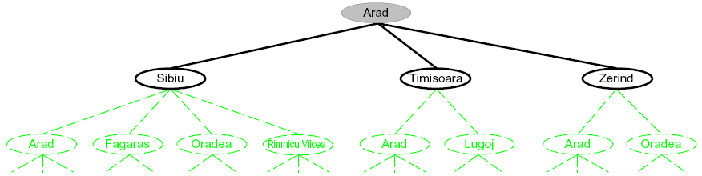
Searching with a Search Tree
Search:
Expand out potential plans (tree nodes)
Maintain a fringe of partial plans under consideration
Try to expand as few tree nodes as possible

Slide 26
General Tree Search
Important ideas:
Fringe
Expansion
Exploration strategy
Main question: which fringe nodes to explore?

Slide 27
Example: Tree Search
a
G
b
c
d
e
f
S
h
p
q
r
Notes:
Left: show tree
Right: fringe

Slide 28
Example: Tree Search
a
G
b
c
e
d
e
d
f
f
S
h
p
r
q
r
S
s
s → d
s → e
s → p
s → d → b
s → d → c
s → d → e
s → d → e → h
s → d → e → r
s → d → e → r → f
s → d → e → r → f → c
s → d → e → r → f → G
d
e
p
b
c
e
h
r
q
a
a
h
r
p
q
f
p
q
f
q
c
G
q
c
G
a
a

Slide 29

Depth-First Search

Slide 30
Depth-First Search
Strategy: expand a deepest node first
Implementation: Fringe is a LIFO stack
a
G
a
c
b
c
b
e
d
e
d
f
f
S
h
h
p
p
r
q
r
q
S
d
e
p
b
c
e
h
r
q
a
a
h
r
p
q
f
p
q
f
q
c
G
q
c
G
a
a

Slide 31
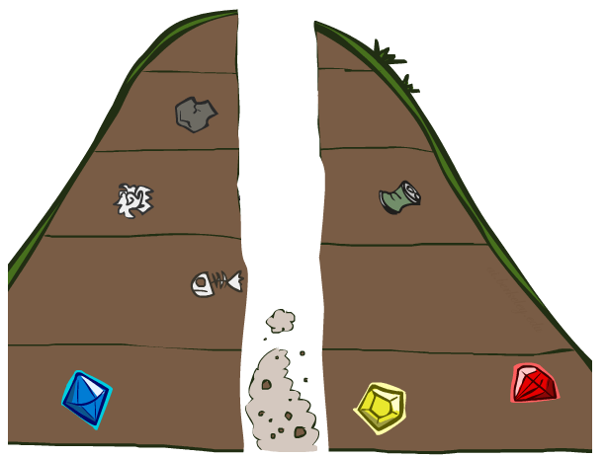
Search Algorithm Properties

Slide 32
Search Algorithm Properties
Complete: Guaranteed to find a solution if one exists?
Optimal: Guaranteed to find the least cost path?
Time complexity?
Space complexity?
Cartoon of search tree:
b is the branching factor
m is the maximum depth
solutions at various depths
Number of nodes in entire tree?
1 + b + b² + …. b^{m} = O(b^{m})
1 node
b
…
b nodes
b² nodes
m tiers
b^{m} nodes

Slide 33
Depth-First Search (DFS) Properties
What nodes DFS expand?
Some left prefix of the tree.
Could process the whole tree!
If m is finite, takes time O(b^{m})
How much space does the fringe take?
Only has siblings on path to root, so O(bm)
Is it complete?
m could be infinite, so only if we prevent cycles (more later)
Is it optimal?
No, it finds the “leftmost” solution, regardless of depth or cost
1 node
b
…
b nodes
b² nodes
m tiers
b^{m} nodes

Slide 34
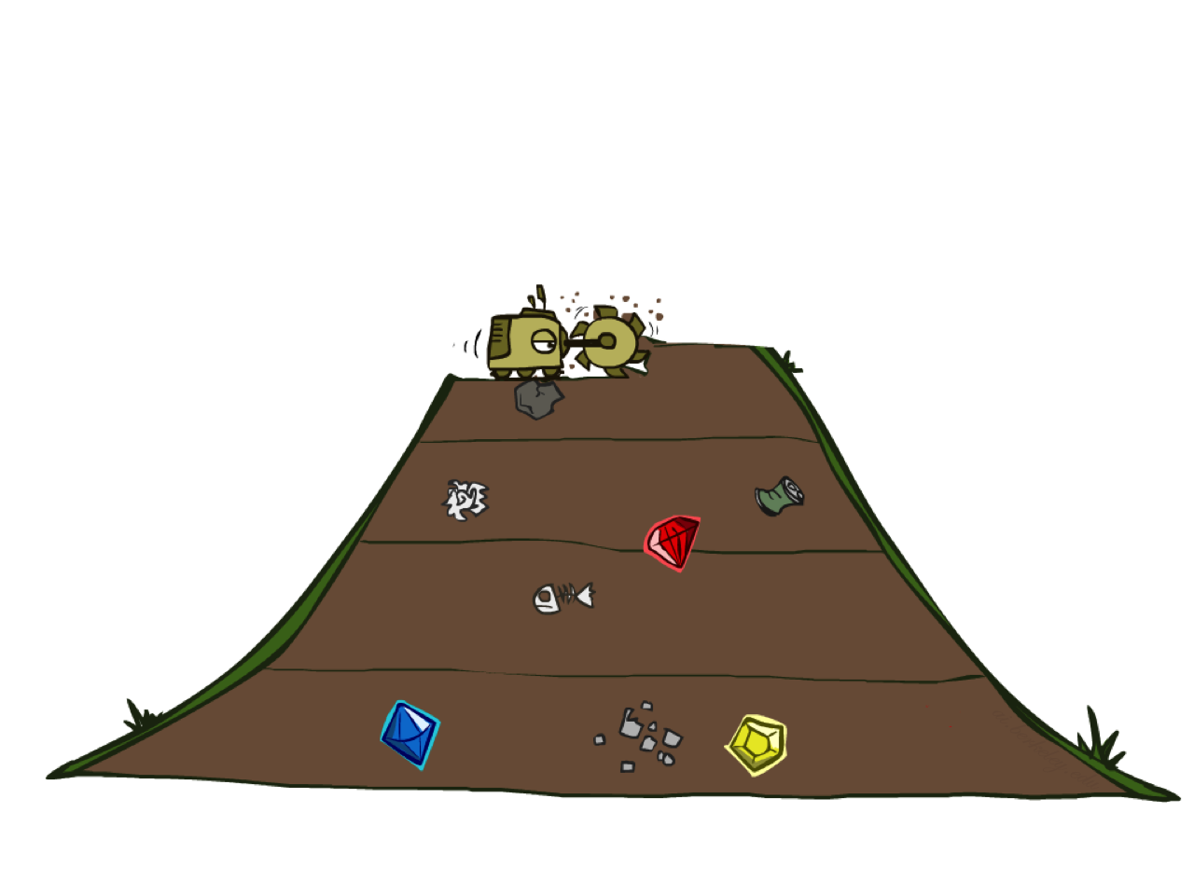
Breadth-First Search

Slide 35
Breadth-First Search
Strategy: expand a shallowest node first
Implementation: Fringe is a FIFO queue
a
G
b
c
d
e
f
S
h
p
q
r
S
d
e
p
Search
Tiers
b
c
e
h
r
q
a
a
h
r
p
q
f
p
q
f
q
c
G
q
c
G
a
a

Slide 36
Breadth-First Search (BFS) Properties
What nodes does BFS expand?
Processes all nodes above shallowest solution
Let depth of shallowest solution be s
Search takes time O(b^{s})
How much space does the fringe take?
Has roughly the last tier, so O(b^{s})
Is it complete?
s must be finite if a solution exists, so yes!
Is it optimal?
Only if costs are all 1 (more on costs later)
1 node
b
…
b nodes
s tiers
b² nodes
b^{s} nodes
b^{m} nodes

Slide 37
DFS vs BFS
When will BFS outperform DFS?
When will DFS outperform BFS?

Slide 38
Iterative Deepening
Idea: get DFS’s space advantage with BFS’s time / shallow-solution advantages
Run a DFS with depth limit 1. If no solution…
Run a DFS with depth limit 2. If no solution…
Run a DFS with depth limit 3. …..
Isn’t that wastefully redundant?
Generally most work happens in the lowest level searched, so not so bad!
b
…

Slide 39
Cost-Sensitive Search
a
GOAL
2
2
b
c
3
2
1
8
2
e
d
f
3
9
8
2
START
h
1
4
2
p
4
r
15
q
BFS finds the shortest path in terms of number of actions.
It does not find the least-cost path. We will now cover
a similar algorithm which does find the least-cost path.

Slide 40

Uniform Cost Search

Slide 41
Uniform Cost Search
2
G
a
Strategy: expand a cheapest node first:
Fringe is a priority queue (priority: cumulative cost)
b
c
1
8
2
2
e
3
d
f
9
8
2
S
h
1
1
p
q
r
15
0
S
d
3
e
9
p
1
b
4
e
5
h
17
r
11
q
16
c
11
Cost contours
a
6
a
h
13
r
7
p
q
f
p
q
f
8
q
c
G
q
c
a
11
G
10
a

Slide 42
Uniform Cost Search (UCS) Properties
What nodes does UCS expand?
Processes all nodes with cost less than cheapest solution!
If that solution costs C* and arcs cost at least ε , then the “effective depth” is roughly C*/ε
Takes time O(b^{C*/ε}) (exponential in effective depth)
How much space does the fringe take?
Has roughly the last tier, so O(b^{C*/ε})
Is it complete?
Assuming best solution has a finite cost and minimum arc cost is positive, yes!
Is it optimal?
Yes! (Proof next lecture via A*)
b
c ≤ 1
…
C*/ε “tiers”
c ≤ 2
c ≤ 3

Slide 43
Uniform Cost Issues
Remember: UCS explores increasing cost contours
The good: UCS is complete and optimal!
The bad:
Explores options in every “direction”
No information about goal location
…
c ≤ 1
c ≤ 2
c ≤ 3
Start
Goal

Slide 44
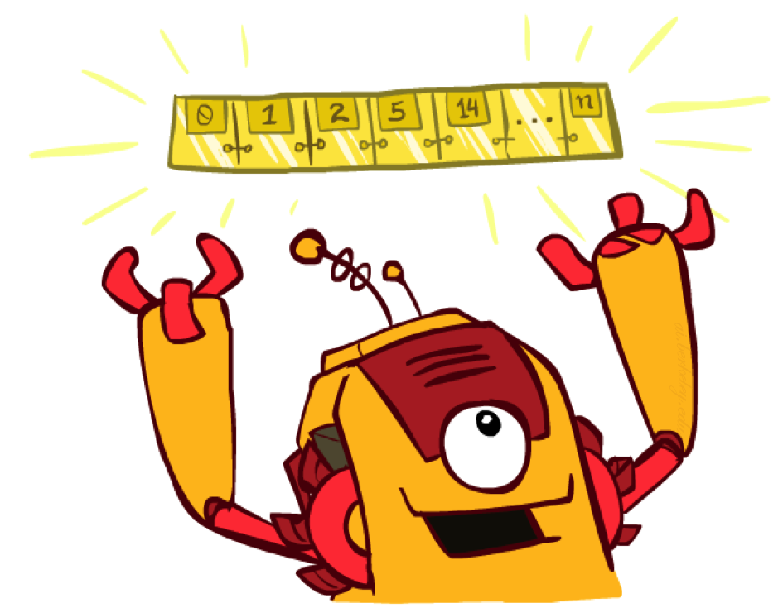
The One Queue
All these search algorithms are the same except for fringe strategies
Conceptually, all fringes are priority queues (i.e. collections of nodes with attached priorities)
Practically, for DFS and BFS, you can avoid the log(n) overhead from an actual priority queue, by using stacks and queues
Can even code one implementation that takes a variable queuing object

Slide 45
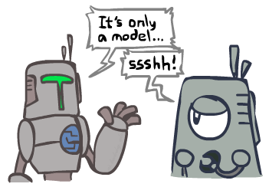
Search and Models
Search operates over models of the world
The agent doesn’t actually try all the plans out in the real world!
Planning is all “in simulation”
Your search is only as good as your models…

Slide 46
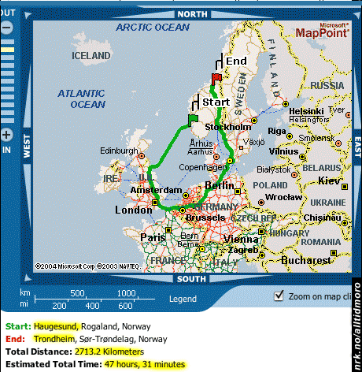
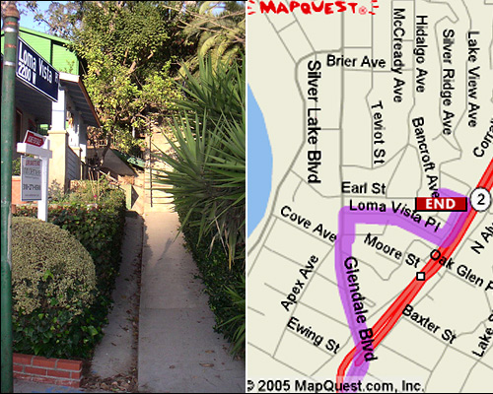

Search Gone Wrong?

Slide 47
Example: Pancake Problem
Cost: Number of pancakes flipped
Notes:
Gates, W. and Papadimitriou, C., "Bounds for Sorting by Prefix Reversal.", Discrete Mathematics. 27, 47-57, 1979.

Slide 48
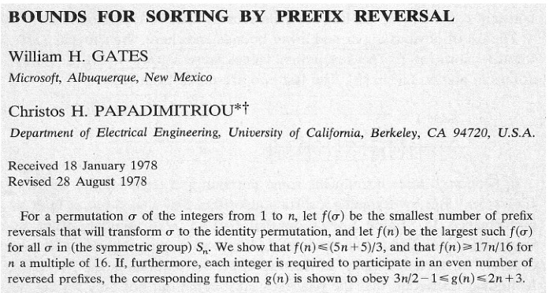
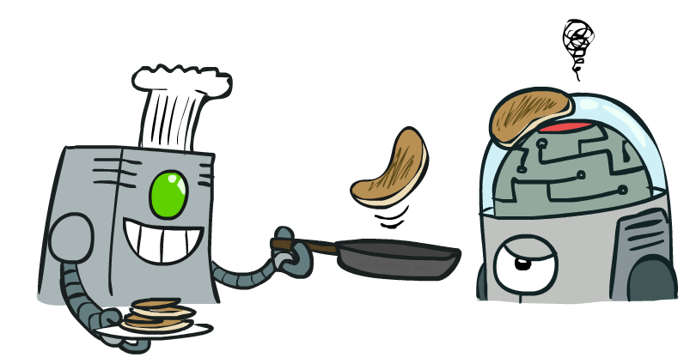
Example: Pancake Problem
Notes:
Gates, W. and Papadimitriou, C., "Bounds for Sorting by Prefix Reversal.", Discrete Mathematics. 27, 47-57, 1979.

Slide 49
Example: Pancake Problem
State space graph with costs as weights
4
2
3
2
3
4
3
4
2
3
2
2
4
3
Notes:
A* expanded 8100 ; Path cost = 33
UCS expanded 25263 . Path cost = 33
Greedy expanded 10 . Path cost = 41
[0, 7, 5, 3, 2, 1, 4, 6]
(7, 0, 5, 3, 2, 1, 4, 6)
(6, 4, 1, 2, 3, 5, 0, 7)
(3, 2, 1, 4, 6, 5, 0, 7)
(1, 2, 3, 4, 6, 5, 0, 7)
(5, 6, 4, 3, 2, 1, 0, 7)
(6, 5, 4, 3, 2, 1, 0, 7)
(0, 1, 2, 3, 4, 5, 6, 7)

Slide 50
General Tree Search
Action: flip top two Cost: 2
Action: flip all four Cost: 4
Path to reach goal:
Flip four, flip three
Total cost: 7
Notes:
You know exactly where you came from and how you got there, but you have no idea where you’re going. But, you’ll know it when you see it.

Slide 51
Uniform Cost Search
Strategy: expand lowest path cost
The good: UCS is complete and optimal!
The bad:
Explores options in every “direction”
No information about goal location
c ≤ 1
…
c ≤ 2
c ≤ 3
Start
Goal

Slide 53

Informed Search

Slide 54



Search Heuristics
A heuristic is:
A function that estimates how close a state is to a goal
Designed for a particular search problem
Examples: Manhattan distance, Euclidean distance for pathing
10
5
11.2

Slide 55
Example: Heuristic Function
h(x)

Slide 56
Example: Heuristic Function
Heuristic: the number of the largest pancake that is still out of place
3
h(x)
4
3
4
3
0
4
4
3
4
4
2
3
Notes:
A* expanded 8100 ; Path cost = 33
UCS expanded 25263 . Path cost = 33
Greedy expanded 10 . Path cost = 41
[0, 7, 5, 3, 2, 1, 4, 6]
(7, 0, 5, 3, 2, 1, 4, 6)
(6, 4, 1, 2, 3, 5, 0, 7)
(3, 2, 1, 4, 6, 5, 0, 7)
(1, 2, 3, 4, 6, 5, 0, 7)
(5, 6, 4, 3, 2, 1, 0, 7)
(6, 5, 4, 3, 2, 1, 0, 7)
(0, 1, 2, 3, 4, 5, 6, 7)

Slide 57

Greedy Search

Slide 58
Example: Heuristic Function
h(x)

Slide 60
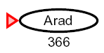

Greedy Search
Expand the node that seems closest…
What can go wrong?

Slide 61
Greedy Search
b
Strategy: expand a node that you think is closest to a goal state
Heuristic: estimate of distance to nearest goal for each state
A common case:
Best-first takes you straight to the (wrong) goal
Worst-case: like a badly-guided DFS
…
b
…
Notes:
For any search problem, you know the goal. Now, you have an idea of how far away you are from the goal.

Slide 62
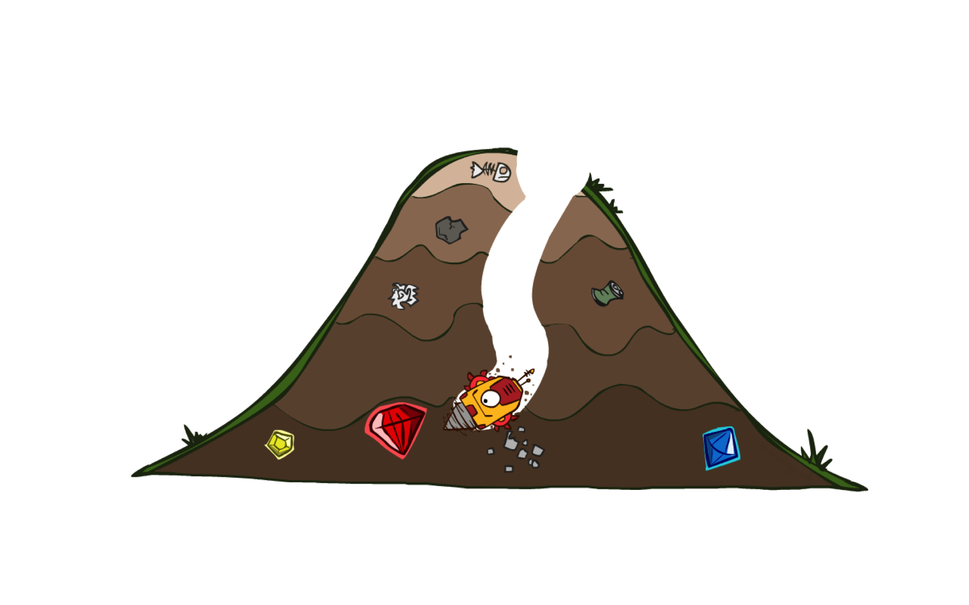
A* Search

Slide 63
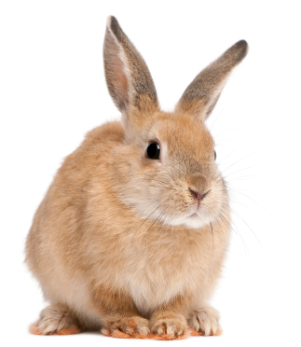
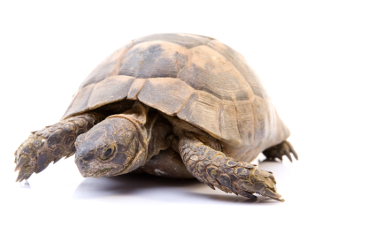
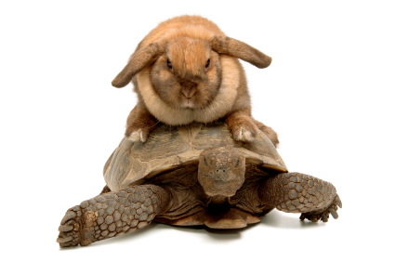
A* Search
UCS
Greedy
A*
Notes:
Notes: these images licensed from iStockphoto for UC Berkeley use.

Slide 66
Example: Heuristic Function
h(x)

Slide 68
Combining UCS and Greedy
Uniform-cost orders by path cost, or backward cost g(n)
Greedy orders by goal proximity, or forward cost h(n)
A* Search orders by the sum: f(n) = g(n) + h(n)
8
g = 0 h=6
S
e
h=1
g = 1 h=5
a
1
1
3
2
g = 2 h=6
g = 9 h=1
S
a
d
G
b
d
g = 4 h=2
e
h=6
1
h=5
h=2
h=0
1
g = 3 h=7
g = 6 h=0
g = 10 h=2
c
b
c
G
d
h=7
h=6
g = 12 h=0
G

Slide 69
When should A* terminate?
Should we stop when we enqueue a goal?
No: only stop when we dequeue a goal
h = 2
A
2
2
S
h = 3
h = 0
G
2
B
3
h = 1

Slide 70
Is A* Optimal?
h = 6
1
A
3
S
h = 7
G
h = 0
5
What went wrong?
Actual bad goal cost < estimated good goal cost
We need estimates to be less than actual costs!

Slide 71

Admissible Heuristics

Slide 72

Idea: Admissibility
Inadmissible (pessimistic) heuristics break optimality by trapping good plans on the fringe
Admissible (optimistic) heuristics slow down bad plans but never outweigh true costs

Slide 73


Admissible Heuristics
A heuristic h is admissible (optimistic) if:
where is the true cost to a nearest goal
Examples:
Coming up with admissible heuristics is most of what’s involved in using A* in practice.
4
15

Slide 74

Optimality of A* Tree Search

Slide 75


Optimality of A* Tree Search
Assume:
A is an optimal goal node
B is a suboptimal goal node
h is admissible
Claim:
A will exit the fringe before B
…

Slide 76


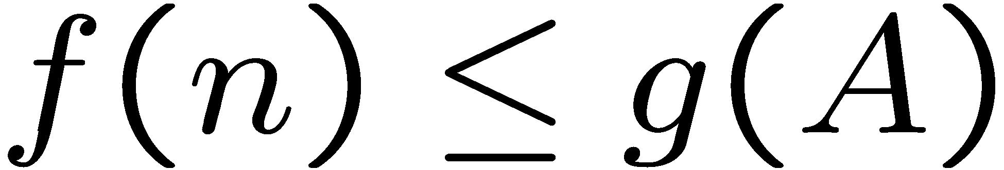
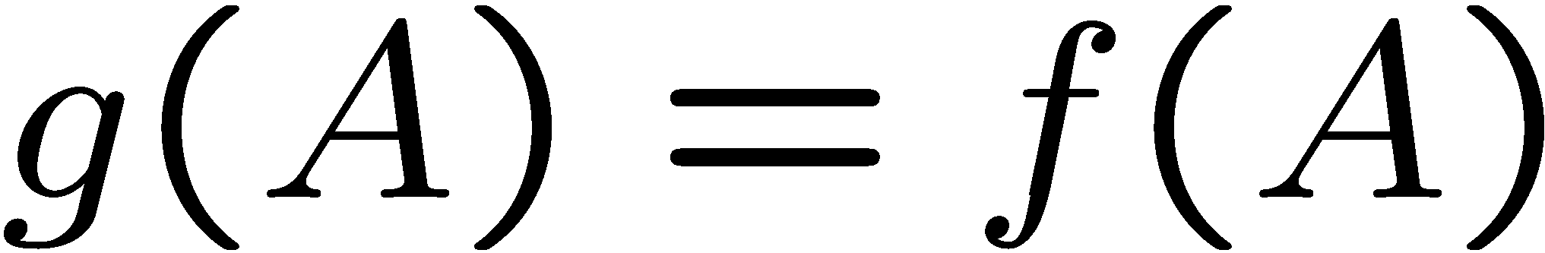
Optimality of A* Tree Search: Blocking
Proof:
Imagine B is on the fringe
Some ancestor n of A is on the fringe, too (maybe A!)
Claim: n will be expanded before B
f(n) is less or equal to f(A)
…
Definition of f-cost
Admissibility of h
h = 0 at a goal

Slide 77


Optimality of A* Tree Search: Blocking
Proof:
Imagine B is on the fringe
Some ancestor n of A is on the fringe, too (maybe A!)
Claim: n will be expanded before B
f(n) is less or equal to f(A)
f(A) is less than f(B)
…
B is suboptimal
h = 0 at a goal

Slide 78

Optimality of A* Tree Search: Blocking
Proof:
Imagine B is on the fringe
Some ancestor n of A is on the fringe, too (maybe A!)
Claim: n will be expanded before B
f(n) is less or equal to f(A)
f(A) is less than f(B)
n expands before B
All ancestors of A expand before B
A expands before B
A* search is optimal
…

Slide 79
Properties of A*

Slide 80
Properties of A*
Uniform-Cost
A*
b
b
…
…

Slide 81
UCS vs A* Contours
Uniform-cost expands equally in all “directions”
A* expands mainly toward the goal, but does hedge its bets to ensure optimality
Start
Goal
Start
Goal

Slide 82



Comparison
Greedy
Uniform Cost
A*

Slide 83
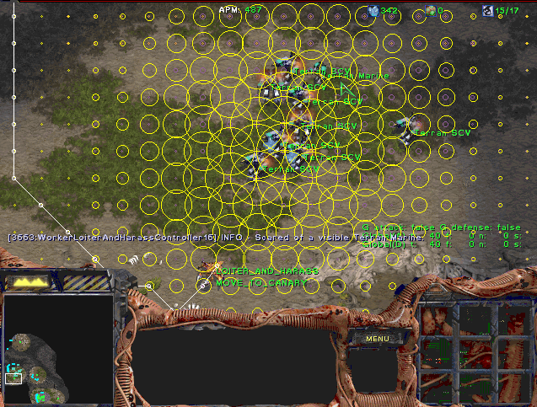
A* Applications

Slide 84
A* Applications
Video games
Pathing / routing problems
Resource planning problems
Robot motion planning
Language analysis
Machine translation
Speech recognition
…

Slide 85

Creating Heuristics

Slide 86
Creating Admissible Heuristics
Most of the work in solving hard search problems optimally is in coming up with admissible heuristics
Often, admissible heuristics are solutions to relaxed problems, where new actions are available
Inadmissible heuristics are often useful too
366
15

Slide 87
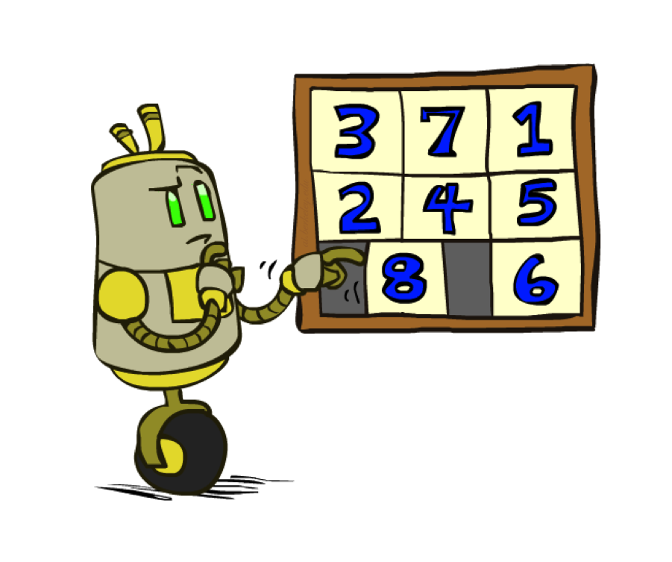
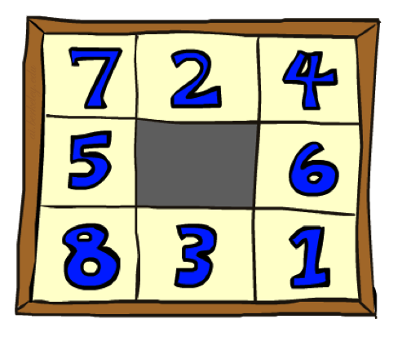
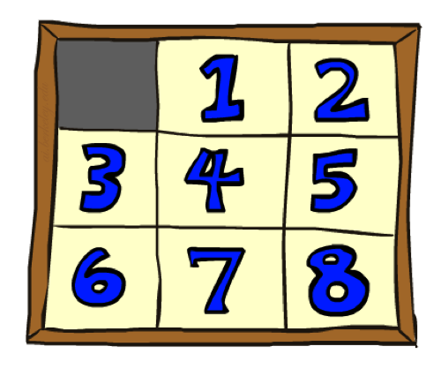
Example: 8 Puzzle
Start State
Actions
Goal State
What are the states?
How many states?
What are the actions?
How many successors from the start state?
What should the costs be?

Slide 88
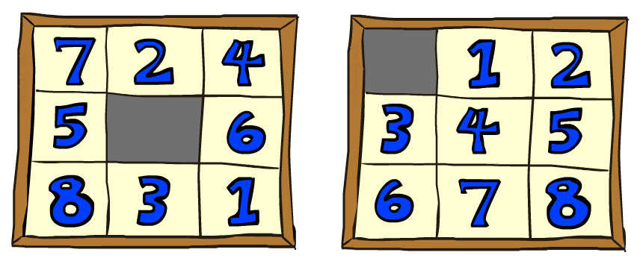
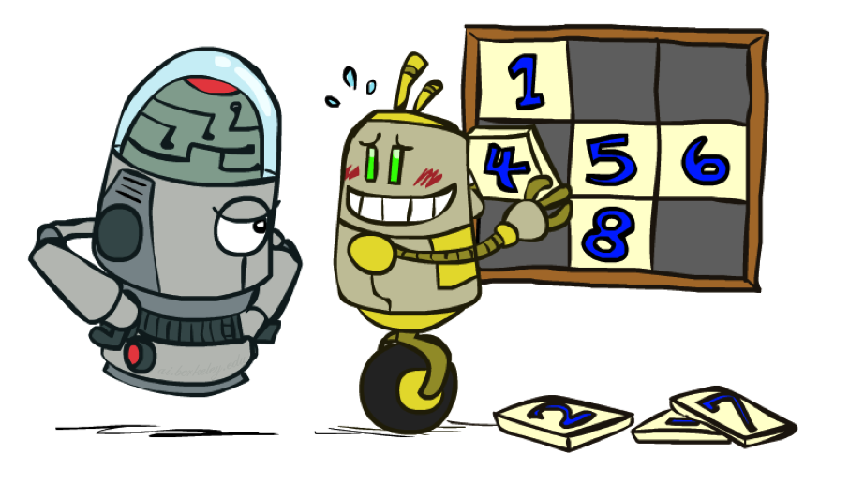
8 Puzzle I
Heuristic: Number of tiles misplaced
Why is it admissible?
h(start) =
This is a relaxed-problem heuristic
8
Start State
Goal State
 | Average nodes expanded when the optimal path has…
 | …4 steps | …8 steps | …12 steps
UCS | 112 | 6,300 | 3.6 x 10⁶
TILES | 13 | 39 | 227
Statistics from Andrew Moore

Slide 89
8 Puzzle II
What if we had an easier 8-puzzle where any tile could slide any direction at any time, ignoring other tiles?
Total Manhattan distance
Why is it admissible?
h(start) =
Start State
Goal State
 | Average nodes expanded when the optimal path has…
 | …4 steps | …8 steps | …12 steps
TILES | 13 | 39 | 227
MANHATTAN | 12 | 25 | 73
3 + 1 + 2 + … = 18

Slide 90
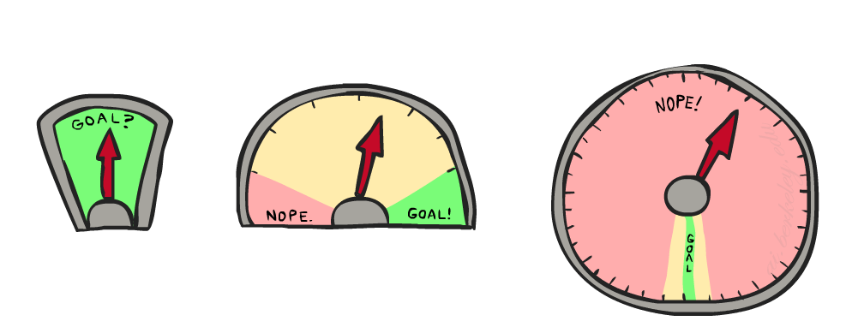
8 Puzzle III
How about using the actual cost as a heuristic?
Would it be admissible?
Would we save on nodes expanded?
What’s wrong with it?
With A*: a trade-off between quality of estimate and work per node
As heuristics get closer to the true cost, you will expand fewer nodes but usually do more work per node to compute the heuristic itself

Slide 95
Example: Heuristic Function
h(x)

Slide 98
Semi-Lattice of Heuristics

Slide 99

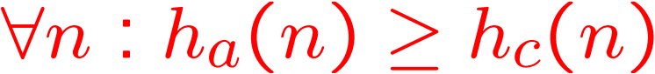
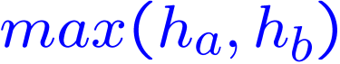

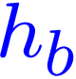


Trivial Heuristics, Dominance
Dominance: h_{a} ≥ h_{c} if
Heuristics form a semi-lattice:
Max of admissible heuristics is admissible
Trivial heuristics
Bottom of lattice is the zero heuristic (what does this give us?)
Top of lattice is the exact heuristic
Notes:
Semi-lattice: x <= y <-> x = x ^ y

Slide 100
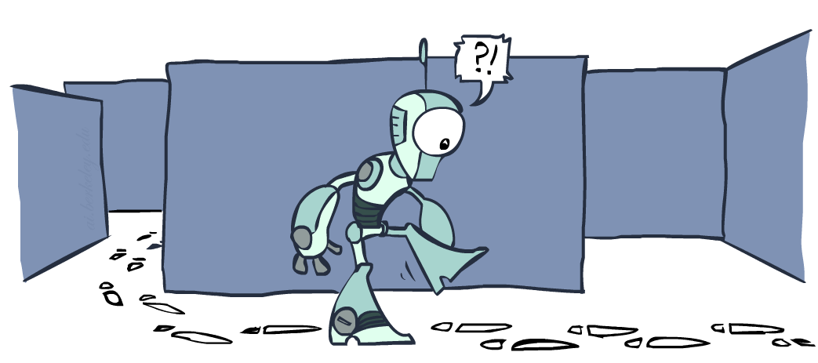
Graph Search

Slide 101
Tree Search: Extra Work!
Failure to detect repeated states can cause exponentially more work.
State Graph
Search Tree

Slide 102
Graph Search
In BFS, for example, we shouldn’t bother expanding the circled nodes (why?)
S
d
e
p
b
c
e
h
r
q
a
a
h
r
p
q
f
p
q
f
q
c
G
q
c
G
a
a

Slide 103
Graph Search
Idea: never expand a state twice
How to implement:
Tree search + set of expanded states (“closed set”)
Expand the search tree node-by-node, but…
Before expanding a node, check to make sure its state has never been expanded before
If not new, skip it, if new add to closed set
Important: store the closed set as a set, not a list
Can graph search wreck completeness? Why/why not?
How about optimality?

Slide 104
A* Graph Search Gone Wrong?
State space graph
Search tree
A
S (0+2)
1
S
1
C
h=4
h=1
A (1+4)
B (1+1)
h=2
1
2
B
3
C (2+1)
C (3+1)
h=1
G
G (5+0)
G (6+0)
h=0

Slide 105
Consistency of Heuristics
Main idea: estimated heuristic costs ≤ actual costs
Admissibility: heuristic cost ≤ actual cost to goal
h(A) ≤ actual cost from A to G
Consistency: heuristic “arc” cost ≤ actual cost for each arc
h(A) – h(C) ≤ cost(A to C)
Consequences of consistency:
The f value along a path never decreases
h(A) ≤ cost(A to C) + h(C)
A* graph search is optimal
A
1
C
h=4
h=1
h=2
3
G

Slide 106
Optimality of A* Graph Search

Slide 107
Optimality of A* Graph Search
Sketch: consider what A* does with a consistent heuristic:
Fact 1: In tree search, A* expands nodes in increasing total f value (f-contours)
Fact 2: For every state s, nodes that reach s optimally are expanded before nodes that reach s suboptimally
Result: A* graph search is optimal
…
f ≤ 1
f ≤ 2
f ≤ 3

Slide 108
Optimality
Tree search:
A* is optimal if heuristic is admissible
UCS is a special case (h = 0)
Graph search:
A* optimal if heuristic is consistent
UCS optimal (h = 0 is consistent)
Consistency implies admissibility
In general, most natural admissible heuristics tend to be consistent, especially if from relaxed problems

Slide 109

A*: Summary

Slide 110

A*: Summary
A* uses both backward costs and (estimates of) forward costs
A* is optimal with admissible / consistent heuristics
Heuristic design is key: often use relaxed problems

Slide 111
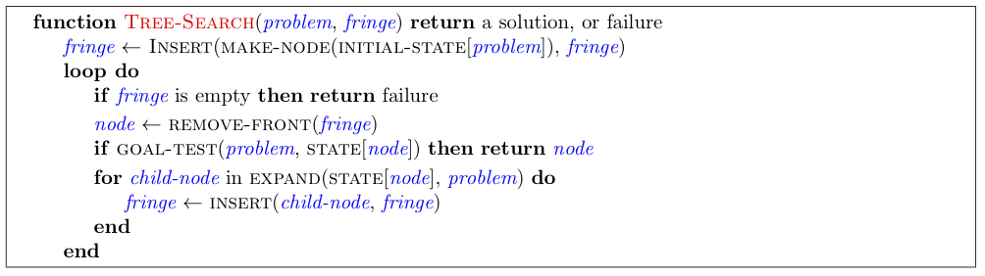
Tree Search Pseudo-Code

Slide 112
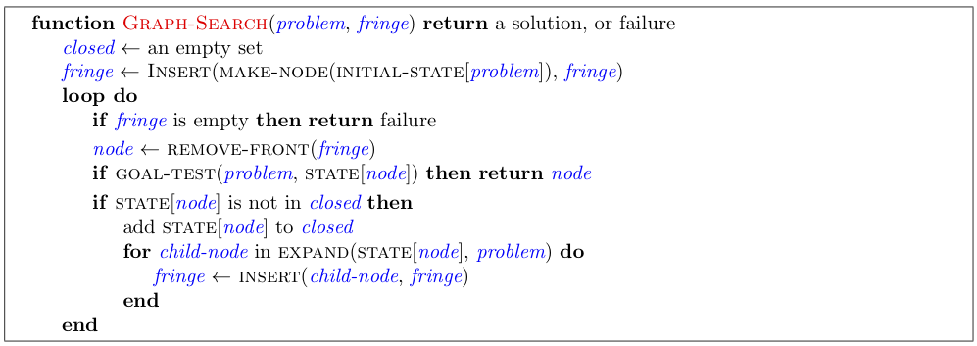
Graph Search Pseudo-Code

Slide 113
Optimality of A* Graph Search
Consider what A* does:
Expands nodes in increasing total f value (f-contours) Reminder: f(n) = g(n) + h(n) = cost to n + heuristic
Proof idea: the optimal goal(s) have the lowest f value, so it must get expanded first
…
f ≤ 1
There’s a problem with this argument. What are we assuming is true?
f ≤ 2
f ≤ 3

Slide 114




Optimality of A* Graph Search
Proof:
New possible problem: some n on path to G* isn’t in queue when we need it, because some worse n’ for the same state dequeued and expanded first (disaster!)
Take the highest such n in tree
Let p be the ancestor of n that was on the queue when n’ was popped
f(p) < f(n) because of consistency
f(n) < f(n’) because n’ is suboptimal
p would have been expanded before n’
Contradiction!

Slide 116
More Search Methods
Local Search
Hill Climbing
Simulated Annealing
Beam Search
Genetic Search
Local Search in Continuous Spaces
Searching with Nondeterministic Actions
Online Search (agent is executing actions)

Slide 117
Local Search Algorithms and Optimization Problems
Complete state formulation
For example, for the 8 queens problem, all 8 queens are on the board and need to be moved around to get to a goal state
Equivalent to optimization problems often found in science and engineering
Start somewhere and try to get to the solution from there
Local search around the current state to decide where to go next

Slide 118
Goal Satisfaction
Optimization
reach the goal node
Constraint satisfaction
optimize(objective fn)
Constraint Optimization
You can go back and forth between the two problems
Typically in the same complexity class

Slide 119
Local search and optimization
Local search
Keep track of single current state
Move only to neighboring states
Ignore paths
Advantages:
Use very little memory
Can often find reasonable solutions in large or infinite (continuous) state spaces.
“Pure optimization” problems
All states have an objective function
Goal is to find state with max (or min) objective value
Does not quite fit into path-cost/goal-state formulation
Local search can do quite well on these problems.

Slide 120
Trivial Algorithms
Random Sampling
Generate a state randomly
Random Walk
Randomly pick a neighbor of the current state
Both algorithms asymptotically complete.

Slide 121
Hill-climbing (Greedy Local Search) max version
function HILL-CLIMBING( problem) return a state that is a local maximum
input: problem, a problem
local variables: current, a node.
neighbor, a node.
current ← MAKE-NODE(INITIAL-STATE[problem])
loop do
neighbor ← a highest valued successor of current
if VALUE [neighbor] ≤ VALUE[current] then return STATE[current]
current ← neighbor
min version will reverse inequalities and look for lowest valued successor

Slide 122
Hill-climbing search
“a loop that continuously moves towards increasing value”
terminates when a peak is reached
Aka greedy local search
Value can be either
Objective function value
Heuristic function value (minimized)
Hill climbing does not look ahead of the immediate neighbors
Can randomly choose among the set of best successors
if multiple have the best value
“climbing Mount Everest in a thick fog with amnesia”

Slide 123
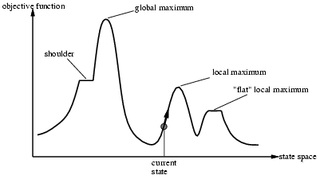
“Landscape” of search
Hill Climbing gets stuck in local minima
depending on?

Slide 124

Example: n-queens
Put n queens on an n x n board with no two queens on the same row, column, or diagonal
Is it a satisfaction problem or optimization?

Slide 125
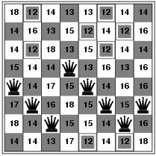
Hill-climbing search: 8-queens problem
Need to convert to an optimization problem
h = number of pairs of queens that are attacking each other
h = 17 for the above state

Slide 126
Search Space
State
All 8 queens on the board in some configuration
Successor function
move a single queen to another square in the same column.
Example of a heuristic function h(n):
the number of pairs of queens that are attacking each other
(so we want to minimize this)

Slide 127
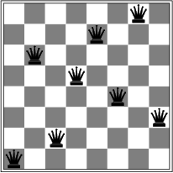
Hill-climbing search: 8-queens problem
Is this a solution?
What is h?

Slide 128
Hill-climbing on 8-queens
Randomly generated 8-queens starting states…
14% the time it solves the problem
86% of the time it get stuck at a local minimum
However…
Takes only 4 steps on average when it succeeds
And 3 on average when it gets stuck
(for a state space with 8^8 =~17 million states)

Slide 129
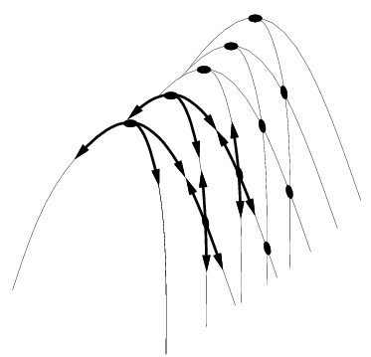
Hill Climbing Drawbacks
Local maxima
Plateaus
Diagonal ridges

Slide 130
Escaping Shoulders: Sideways Move
If no downhill (uphill) moves, allow sideways moves in hope that algorithm can escape
Need to place a limit on the possible number of sideways moves to avoid infinite loops
For 8-queens
Now allow sideways moves with a limit of 100
Raises percentage of problem instances solved from 14 to 94%
However….
21 steps for every successful solution
64 for each failure

Slide 131
Tabu Search
prevent returning quickly to the same state
Keep fixed length queue (“tabu list”)
add most recent state to queue; drop oldest
Never make the step that is currently tabu’ed
Properties:
As the size of the tabu list grows, hill-climbing will asymptotically become “non-redundant” (won’t look at the same state twice)
In practice, a reasonable sized tabu list (say 100 or so) improves the performance of hill climbing in many problems

Slide 132
Escaping Shoulders/local Optima Enforced Hill Climbing
Perform breadth first search from a local optima
to find the next state with better h function
Typically,
prolonged periods of exhaustive search
bridged by relatively quick periods of hill-climbing
Middle ground b/w local and systematic search

Slide 133
Hill-climbing: stochastic variations
Stochastic hill-climbing
Random selection among the uphill moves.
The selection probability can vary with the steepness of the uphill move.
To avoid getting stuck in local minima
Random-walk hill-climbing
Random-restart hill-climbing
Hill-climbing with both

Slide 134
Hill Climbing: stochastic variations
When the state-space landscape has local minima, any search that moves only in the greedy direction cannot be complete
Random walk, on the other hand, is
asymptotically complete
Idea: Put random walk into greedy hill-climbing

Slide 135
Hill-climbing with random restarts
If at first you don’t succeed, try, try again!
Different variations
For each restart: run until termination vs. run for a fixed time
Run a fixed number of restarts or run indefinitely
Analysis
Say each search has probability p of success
E.g., for 8-queens, p = 0.14 with no sideways moves
Expected number of restarts?
Expected number of steps taken?
If you want to pick one local search algorithm, learn this one!!

Slide 136
Hill-climbing with random walk
At each step do one of the two
Greedy: With prob p move to the neighbor with largest value
Random: With prob 1-p move to a random neighbor
Hill-climbing with both
At each step do one of the three
Greedy: move to the neighbor with largest value
Random Walk: move to a random neighbor
Random Restart: Resample a new current state

Slide 137
Hill-climbing
Goal: Optimizing an objective function.
Does not require differentiable functions
Can be applied to “goal” predicate type of problems.
BSAT with objective function number of clauses satisfied.
Intuition: Always move to a better state

Slide 138
Hill-Climbing Search
function HILL-CLIMBING(problem) return a state that is a local maximum
input: problem, a problem
local variables: current, a node.
neighbor, a node.
current ← MAKE-NODE(INITIAL-STATE[problem])
loop do
neighbor ← a highest valued successor of current
if VALUE [neighbor] ≤ VALUE[current] then return STATE[current]
current ← neighbor

Slide 139
Some Hill-Climbing Algo’s
Start = random state or special state.
Until (no improvement)
Steepest Ascent: find best successor
OR (greedy): select first improving successor
Go to that successor
Repeat the above process some number of times (Restarts).
Can be done with partial solutions or full solutions.

Slide 140
Hill-climbing
Implicit in this scheme is the notion of a neighborhood that in some way preserves the cost behavior of the solution space…
Think about the TSP problem again
If I have a current tour what would a neighboring tour look like?
This is a way of asking for a successor function.

Slide 141
Hill-climbing Search
The successor function is where the intelligence lies in hill-climbing search
It has to be conservative enough to preserve significant “good” portions of the current solution
And liberal enough to allow the state space to be preserved without degenerating into a random walk

Slide 142
Hill-climbing Algorithm
In Best-first, replace storage by single node
Works if single hill
Use restarts if multiple hills
Problems:
finds local maximum, not global
plateaux: large flat regions (happens in BSAT)
ridges: fast up ridge, slow on ridge
Not complete, not optimal
No memory problems ☺

Slide 143
Hill Climbing
“Gradient ascent”
solution
Note: solutions shown
here as max not min.
Often used for numerical optimization problems.
How does it work?

Slide 144
AI Hill Climbing
Steepest-Ascent Hill Climbing
current ← start node
loop do
neighbor ← a highest-valued successor of current
if neighbor.Value <= current.Value then return current.State
current ← neighbor
end loop

Slide 145
Hill Climbing Search
current
6
4
10
3
2
8
What if current had a value of 12?

Slide 146
Hill Climbing Problems
Local maxima
Plateaus
Diagonal ridges
What is it sensitive to?
Does it have any advantages?

Slide 147
Local Maxima (Minima)
Hill-climbing is subject to getting stuck in a variety of local conditions…
Two solutions
Stochastic Hill-climbing – chooses random from among the uphill moves
First choice hill-climbing – similar to stochastic but creates successors at random
Random restart hill-climbing – Randomly generates initial states and keep climbing high
Simulated annealing

Slide 148
Random Restart Hillclimbing
Pretty obvious what this is….
Generate a random start state
Run hill-climbing and store answer
Iterate, keeping the current best answer as you go
Stopping… when? – Reaches the goal

Slide 149
Simulated Annealing
Variant of hill climbing (so up is good)
Tries to explore enough of the search space early on, so that the final solution is less sensitive to the start state
May make some downhill moves before finding a good way to move uphill.

Slide 150
Simulated Annealing
Comes from the physical process of annealing in which substances are raised to high energy levels (melted) and then cooled to solid state.
The probability of moving to a higher energy state, instead of lower is
p = e^(-ΔE/kT)
where ΔE is the positive change in energy level, T is the temperature, and k is Bolzmann’s constant.
heat cool

Slide 151
Simulated Annealing
Like hill-climbing, but probabilistically allows down moves, controlled by current temperature and how bad move is.
Let t[1], t[2],… be a temperature schedule.
usually t[1] is high, t[k] = 0.9*t[k-1].
Let E be quality measure of state
Goal: maximize E.

Slide 152
Simulated Annealing Algorithm
Current = random state, k = 1
If T[k] = 0, stop.
Next = random next state
If Next is better than start, move there.
If Next is worse:
Let Delta = E(next)-E(current)
Move to next with probabilty e^(Delta/T[k])
k = k+1

Slide 153
Simulated Annealing Discussion
No guarantees
When T is large, e^delta/t is close to e^0, or 1. So for large T, you go anywhere.
When T is small, e^delta/t is close to e^-inf, or 0. So you avoid most bad moves.
After T becomes 0, one often does simple hill-climbing.
Execution time depends on schedule; memory use is trivial.

Slide 154
Simulated Annealing
At the beginning, the temperature is high.
As the temperature becomes lower
kT becomes lower
ΔE/kT gets bigger
(-ΔE/kT) gets smaller
e^(-ΔE/kT) gets smaller
As the process continues, the probability of a downhill move gets smaller and smaller.

Slide 155
For Simulated Annealing
ΔE represents the change in the value of the objective function.
Since the physical relationships no longer apply, drop k. So p = e^(-ΔE/T)
We need an annealing schedule, which is a sequence of values of T: T₀, T₁, T₂, ...

Slide 156
Simulated Annealing Algorithm
current ← start node;
for each T on the schedule /* need a schedule */
next ← randomly selected successor of current
evaluate next; it it’s a goal, return it
ΔE ← next.Value – current.Value /* already negated */
if ΔE > 0
then current ← next /* better than current */
else current ← next with probability e^(ΔE/T)
How would you do this probabilistic selection?

Slide 157
Simulated annealing
function SIMULATED-ANNEALING( problem, schedule) return a solution state
input: problem, a problem
schedule, a mapping from time to temperature
local variables: current, a node.
next, a node.
T, a “temperature” controlling the probability of downward steps
current ← MAKE-NODE(INITIAL-STATE[problem])
for t ← 1 to ∞ do
T ← schedule[t]
if T = 0 then return current
next ← a randomly selected successor of current
∆E ← VALUE[next] - VALUE[current]
if ∆E > 0 then current ← next
else current ← next only with probability e^{∆E /T}

Slide 158
Properties of simulated annealing search
One can prove: If T decreases slowly enough, then simulated annealing search will find a global optimum with probability approaching 1
Widely used in VLSI layout, airline scheduling, etc

Slide 159
Probabilistic Selection
Select next with probability p
Generate a random number
If it’s <= p, select next
p
0 1
random
number

Slide 160
Simulated Annealing Properties
At a fixed “temperature” T, state occupation probability reaches the Boltzman distribution
If T is decreased slowly enough (very slowly), the procedure will reach the best state.
Slowly enough has proven too slow for some researchers who have developed alternate schedules.
p(x) = αe^(E(x)/kT)

Slide 161
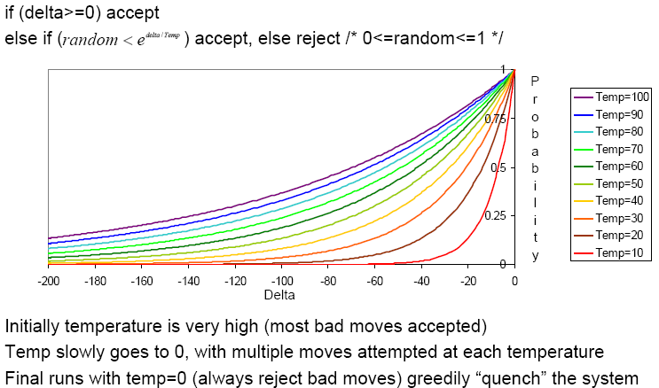
Simulated Annealing Schedules
Acceptance criterion and cooling schedule

Slide 162
Simulated Annealing Applications
Basic Problems
Traveling salesman
Graph partitioning
Matching problems
Graph coloring
Scheduling
Engineering
VLSI design
Placement
Routing
Array logic minimization
Layout
Facilities layout
Image processing
Code design in information theory

Slide 163
Beam
Mix of hill-climbing and best first
Storage is a cache of best K states
Solves storage problem, but…
Not optimal, not complete

Slide 164
Local Beam Search
Keeps more previous states in memory
Simulated annealing just kept one previous state in memory.
This search keeps k states in memory.
- randomly generate k initial states
- if any state is a goal, terminate
- else, generate all successors and select best k
- repeat
Pros? Cons?

Slide 165
Local (Iterative) Improving
Initial state = full candidate solution
Greedy hill-climbing:
if up, do it
if flat, probabilistically decide to accept move
if down, don’t do it
We are gradually expanding the possible moves.

Slide 166
Local Improving: Performance
Solves 1,000,000 queen problem quickly
Useful for scheduling
Useful for BSAT
solves (sometimes) large problems
More time, better answer
No memory problems
No guarantees of anything

Slide 167
Genetic Algorithm
Weakly analogous to “evolution”
No theoretic guarantees
Applies to nearly any problem.
Population = set of individuals
Fitness function on individuals
Mutation operator: new individual from old one.
Cross-over: new individuals from parents

Slide 168
GA Algorithm (a version)
Population = random set of n individuals
Probabilistically choose n pairs of individuals to mate
Probabilistically choose n descendants for next generation (may include parents or not)
Probability depends on fitness function as in simulated annealing.
How well does it work?

Slide 169
Scores to Probabilities
Suppose the scores of the n individuals are:
a[1], a[2],….a[n].
The probability of choosing the jth individual
prob = a[j]/(a[1]+a[2]+….a[n]).

Slide 170
GA Example
Problem Boolean Satisfiability.
Individual = bindings for variables
Mutation = flip a variable
Cross-over = For 2 parents, randomly positions from 1 parent. For one son take those bindings and use other parent for others.
Fitness = number of clauses solved.

Slide 171
GA Example
N-queens problem
Individual: array indicating column where ith queen is assigned.
Mating: Cross-over
Fitness (minimize): number of constraint violations

Slide 172
GA Function Optimization Ex.
Let f(x,y) be the function to optimize.
Domain for x and y is real number between 0 and 10.
Say the hidden function is:
f(x,y) = 2 if x> 9 & y>9.
f(x,y) = 1 if x>9 or y>9
f(x,y) = 0 otherwise.

Slide 173
GA Works Well here.
Individual = point = (x,y)
Mating: something from each so:
mate({x,y},{x’,y’}) is {x,y’} and {x’,y}.
No mutation
Hill-climbing does poorly, GA does well.
This example generalizes functions with large arity.

Slide 174
GA Discussion
Reported to work well on some problems.
Typically not compared with other approaches, e.g. hill-climbing with restarts.
Opinion: Works if the “mating” operator captures good substructures.

Slide 175
Genetic Algorithms
Start with random population of states
Representation serialized (ie. strings of characters or bits)
States are ranked with “fitness function”
Produce new generation
Select random pair(s) using probability:
probability ~ fitness
Randomly choose “crossover point”
Offspring mix halves
Randomly mutate bits
Crossover Mutation
174629844710
174611094281
164611094281
→
→
776511094281
776529844710
776029844210

Slide 176
Genetic Algorithm
Given: population P and fitness-function f
repeat
newP ← empty set
for i = 1 to size(P)
x ← RandomSelection(P,f)
y ← RandomSelection(P,f)
child ← Reproduce(x,y)
if (small random probability) then child ← Mutate(child)
add child to newP
P ← newP
until some individual is fit enough or enough time has elapsed
return the best individual in P according to f

Slide 177
Using Genetic Algorithms
2 important aspects to using them
1. How to encode your real-life problem
2. Choice of fitness function
Research Example
We want to generate a new operator for finding interesting points on images
The operator will be some function of a set of values v₁, v₂, … v_{K}.
Idea: weighted sums, weighted mins, weighted maxs. a₁,…a_{K},b₁,…b_{K},c₁,…c_{k}

Slide 178
Local Search in Continuous Spaces
Given a continuous state space
S = {(x₁,x₂,…,x_{N}) | x_{i} ε R}
Given a continuous objective function f(x₁,x₂,…,x_{N})
The gradient of the objective function is a vector ∇f = (∂f/∂x₁,∂f/∂x₂,…,∂f/∂x_{N})
The gradient gives the magnitude and direction of the steepest slope at a point.

Slide 179
Local Search in Continuous Spaces
To find a maximum, the basic idea is to set ∇f =0
Then updating of the current state becomes
x ← x + α∇f(x)
where α is a small constant.
Theory behind this is taught in numerical methods classes.
Your book suggests the Newton-Raphson method. Luckily there are packages…..

Slide 180
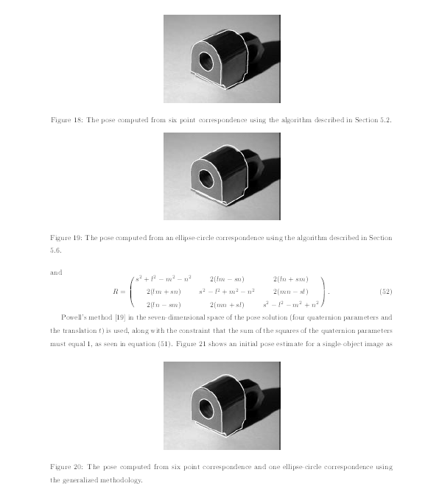
Computer Vision Pose Estimation Example

Slide 181

Computer Vision Pose Estimation Example
Read the “Airports in Romania” example in the text.

Slide 182
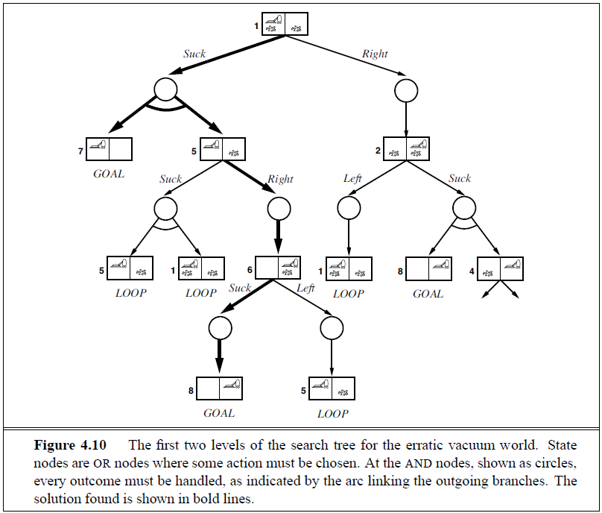
AND-OR Search Tree
OR
Node
AND
Node

Slide 183
Searching with Partial Observations
The agent does not always know its state!
Instead, it maintains a belief state: a set of possible states it might be in.
Example: a robot can be used to build a map of a hostile environment. It will have sensors that allow it to “see” the world.

